Slide 1


Power System Control Shipboard Power System Fundamentals Revision of 2 February 2026
Dr. Norbert Doerry
http://doerry.org/norbert/MarineElectricalPowerSystems/index.htm
© 2026 by Norbert Doerry This work is licensed via: CC BY 4.0 (https://creativecommons.org/)

Slide 2
Essential Questions
What power system control architectures are used on ships and why? | Understand
What is time scale separation in relationship to controls? | Understand
What are the layers of control as defined in IEEE Std. 1676? | Remember
What are the typical power system control functions? | Understand

Slide 3
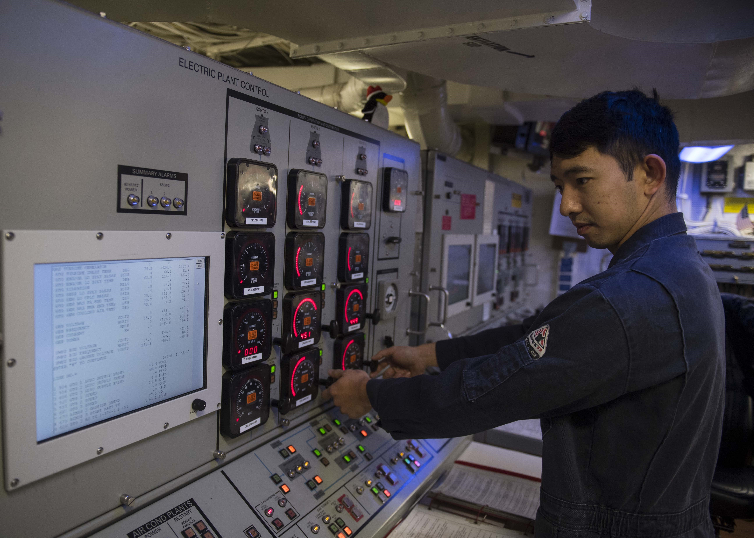
Introduction: Objectives of power system design
“The primary aim of the design of a shipboard electric power system has traditionally been survivability and continuity of the electrical power supply. Survivability relates to the ability of the power system, when damaged by a threat, to support the ship’s ability to continue its missions. Power continuity relates to the ability of the power system to reliably provide power to ship systems under normal operations.”
USS Forrest Sherman (DDG 98) Electric Plant Control Console
Doerry, Norbert, "Designing Electrical Power Systems for Survivability and Quality of Service", presented at ASNE DAY 2007, Arlington, VA, June 25-26, 2007. Also published in ASNE Naval Engineers Journal, 2007, Vol. 119 No 2, pp 25-34.

Slide 4
Electrical Power System control functions
Remote monitoring and control of electrical power system equipment
Resource planning and system configuration to support the EPS-CONOPS
Mission priority load shedding
Coordination of fault detection, fault isolation, and reconfiguration
Optimization of QoS and QoS load shedding
Interfacing with the overall machinery control system
Performance analysis, parameter trending, and logging
Maintenance support
Training

Slide 5
Control System Hardware
Field Device
Converts digital commands to physical actuation.
Converts measurements to digital data.
Input / Output unit
Perform data translation, signal conditioning, and basic signal processing.
Not intended to implement control algorithms.
Controller
Typically, a Programmable Logic Controller (PLC).
Implements control algorithms.
Network
Multi-level to enable communications among control system hardware elements.
Human-Machine Interface (HMI)
Provides operators with situational awareness.
Enables operators to configure or provide control set points for the electrical power system.

Slide 6
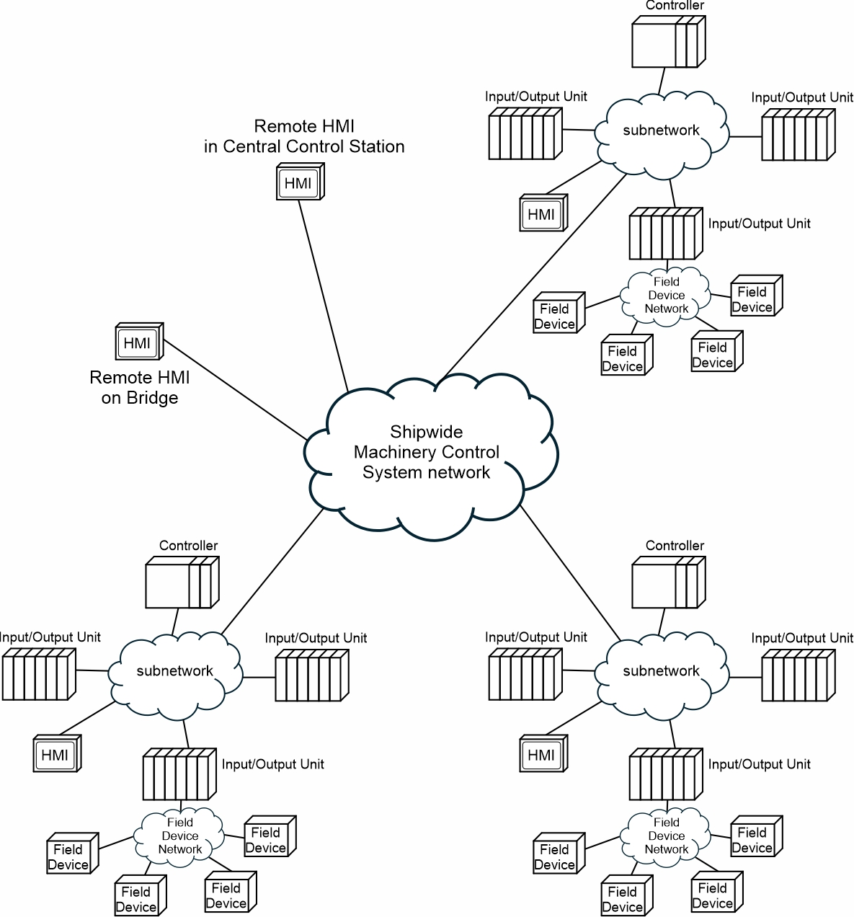
Control System Networks
Field devices
Input/Output unit
Controller
Network
Human Machine Interface (HMI)

Slide 7
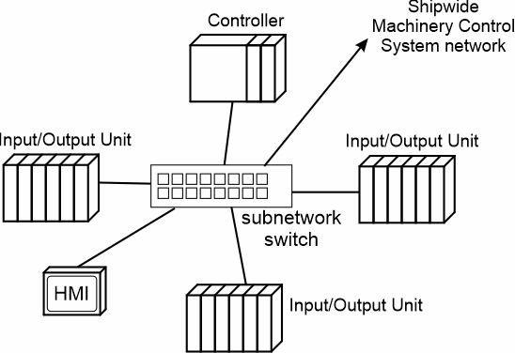
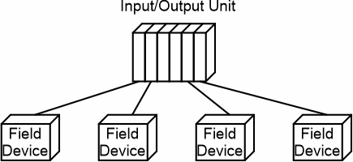
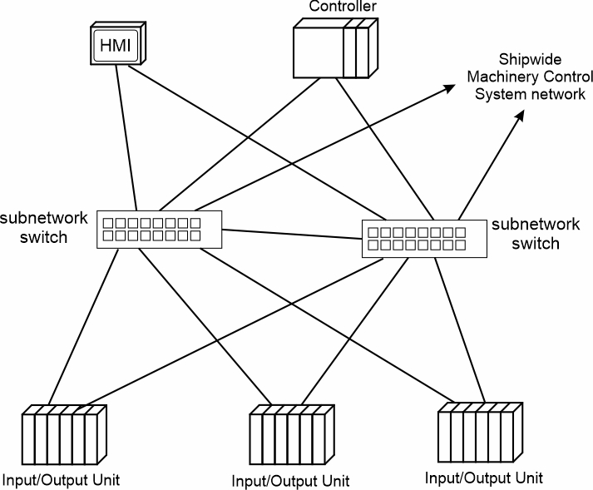
Topologies
Point to point topology
Star topology
Enables multiple interface types between Input/Output unit and Field Devices
Devices connect to the same subnetwork switch using same interface type.
Should be able to function without connection to ship wide machinery control system network.
Like the star topology, but each device connects to two subnetwork switches for increased reliability and survivability
Dual star topology

Slide 8
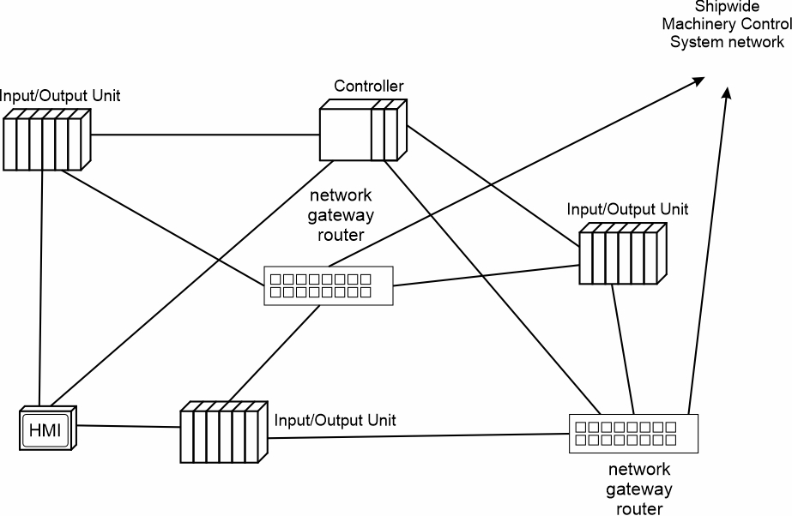
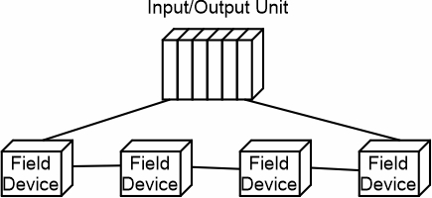
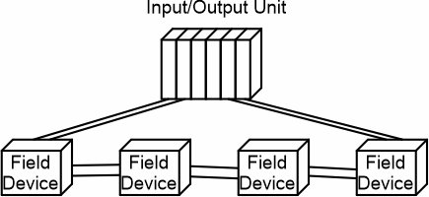
Topologies (continued)
Ring bus topology
Can tolerate loss of a single connection.
Usually requires less cable than other topologies.
Does not require subnetwork switch.
Mesh topology
Each device connects to multiple other devices.
Data may be routed through multiple paths between any two devices.
Can be very reliable and survivable.
Dual ring bus topology
Can tolerate loss of multiple connections.
Requires twice as much cable as Ring Bus.
Does not require subnetwork switch.

Slide 9
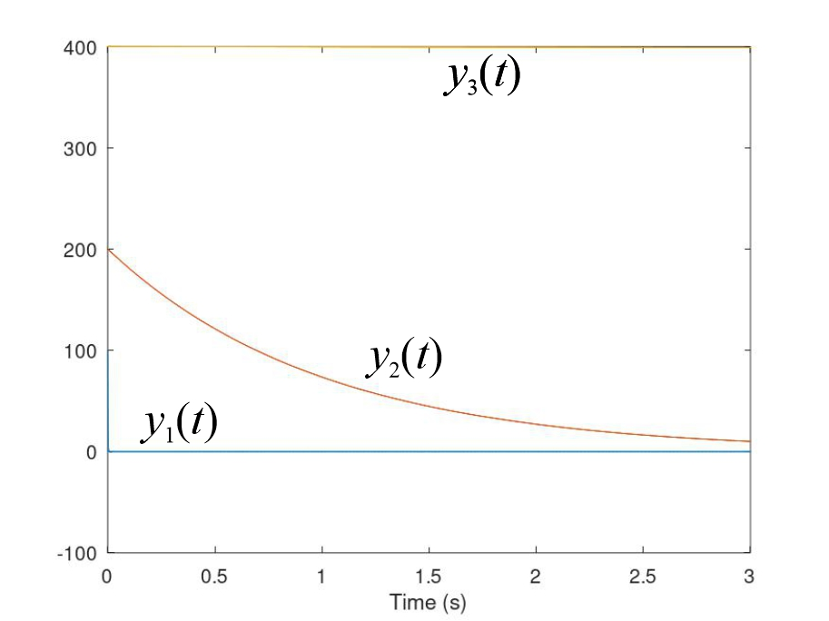
Time scale separation
Partitions the analysis and control of systems with dynamics that are of very different time scales.
Enables each partition to be treated separately from the other partitions.
Each partition has a time scale of interest.
Dynamics that are much slower than the time scale of interest are assumed to be constant at their initial value.
Dynamics that are much faster than the time scale of interest are assumed to have happened instantaneously and have their “final” value.
y₃(t) is much slower
y₂(t) is in time scale of interest
y₁(t) is much faster

Slide 10
IEEE Std. 1676 control layers
System control (characteristic time of 10 ms or greater)
Functions at total ship / zonal level.
Control of generator sets, converters, configuration of bus-tie breakers, commanding load shedding.
Zonal Ships: Multi-zone control, Zonal control, and In-zone control.
Application control (characteristic time of 1 ms to 1 s)
Functions at the power system component level.
Implements control objects provided b system control.
Converter control (characteristic time of 10 μs to 1 ms)
Translate objectives of application control to specific set-points and control schemes for implementation by the switching control.
Switching control (characteristic time of 1 to 10 μs)
Controls the switching logic to implement the control scheme of converter control.
Hardware control
Provides the direct interface with hardware to include snubbers, gate drives, sensors, A/D and D/A conversion, etc.

